Slide 1
100XBOOTCAMP
01
02
03
04
WEB DEV, DEVOPS
WEB3
AI
DSA

Slide 2
Which to chose

Slide 3
Which to chose
Web dev
devops
dsa
Web dev
ai
Web dev
web3

Slide 4
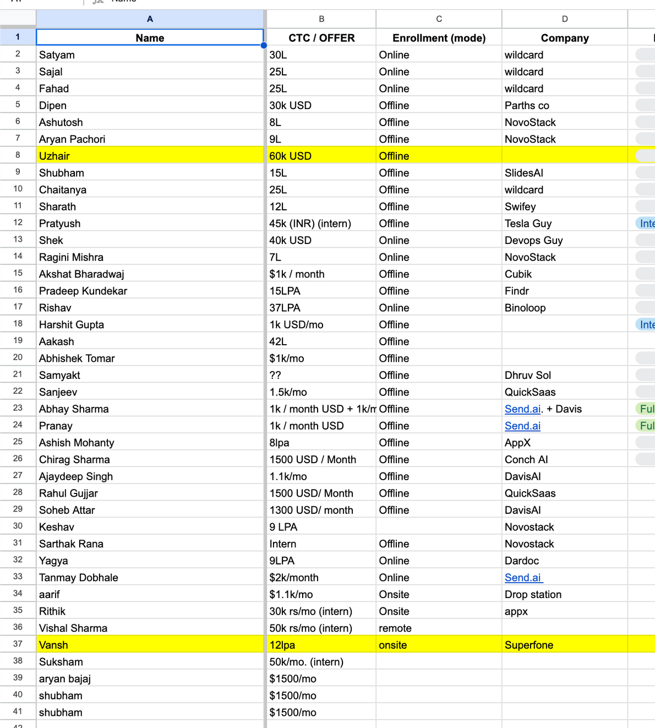
Super 30 1.0
placements
(3 months)

Slide 5
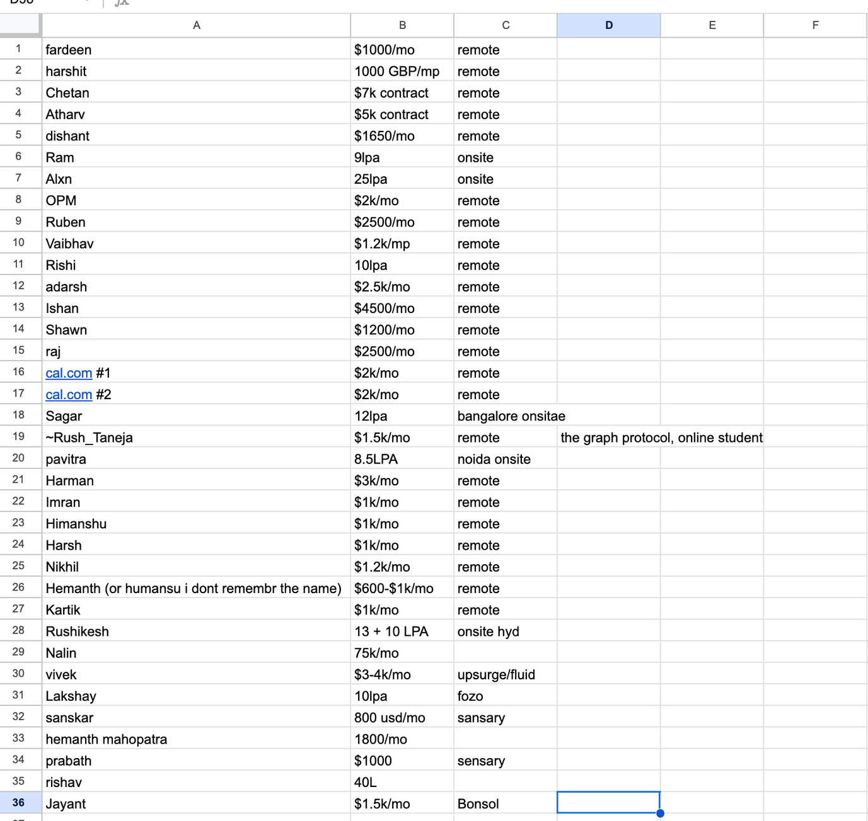
Super 30 2.0
placements
(3 months)

Slide 6
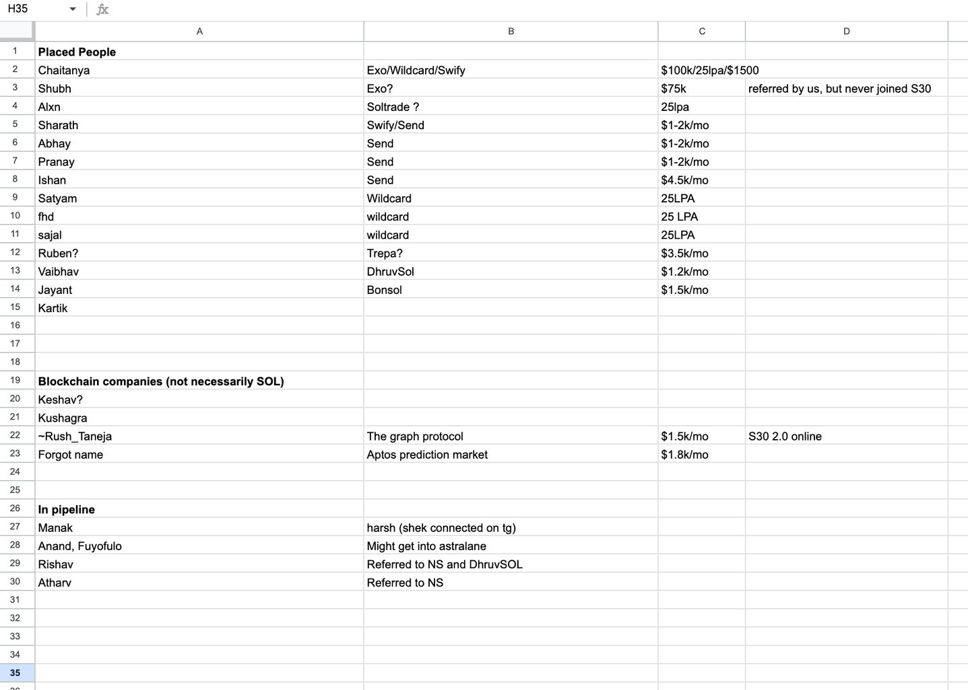
Solana placements

Slide 7
ASSIGNMENTS
ARE IMPORTANT
https://brindle-goal-102.notion.site/Car-Rental-System-Backend-PostgreSQL-JWT-2a846b36b2e980009dbac0ebe0e9b9a7
https://brindle-goal-102.notion.site/Backend-WebSocket-Live-Attendance-System-2c646b36b2e980b09b42d7c0240a8170

Slide 8
S30 ASSIGNMENT STATS
100 TEST
CASES,
50 PARTICIPANTS

Slide 9
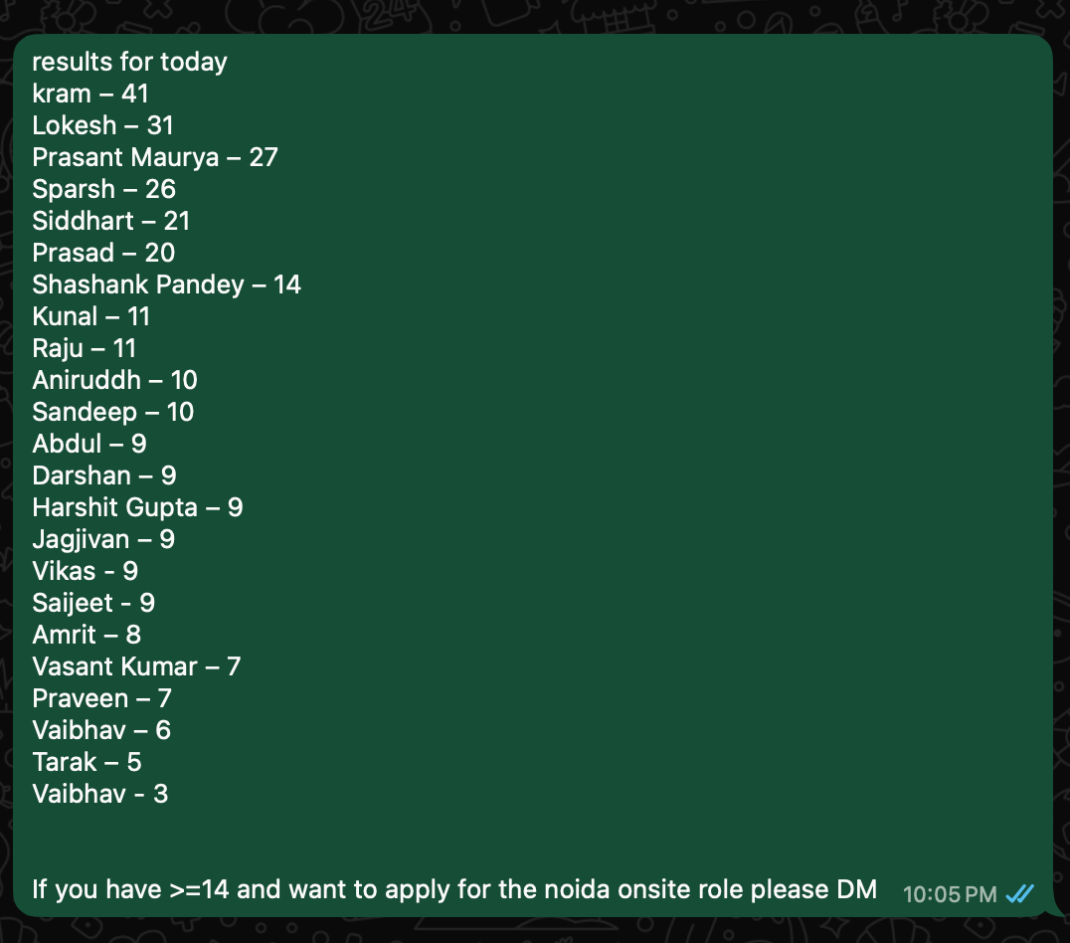
S30 ASSIGNMENT STATS
100 TEST
CASES,
50 PARTICIPANTS

Slide 10
WHY BUILD MUSSCLE MEMORY,
AI CAN CODE ANYTHING?

Slide 11
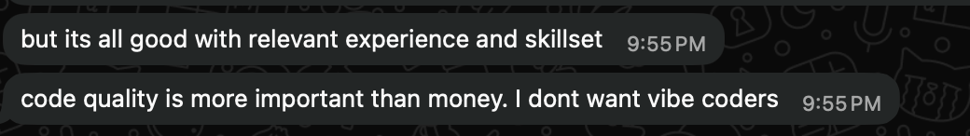
WHY BUILD MUSSCLE MEMORY,
AI CAN CODE ANYTHING?
  JUST SHOWS YOU HAVE BEEN CODING A WHILE (PRE-LLM ERA)
  COMPANIES ARE OPTIMISING FOR ENGINEERS WHO CAN SOLVE THE LAST 5%
  MUSCLE MEMORY BUILDS INTUITION

Slide 12

THERE ARE TAS, BUT NO ONES GOING TO/SHOULD HAND HOLD YOU
At the gym the instructor cant pick up the weights for you

Slide 13
DONT WAIT FOR A WEEK, BE AHEAD
The best S30 students have been people
who are already way ahead/sometimes surprise me as well

Slide 14
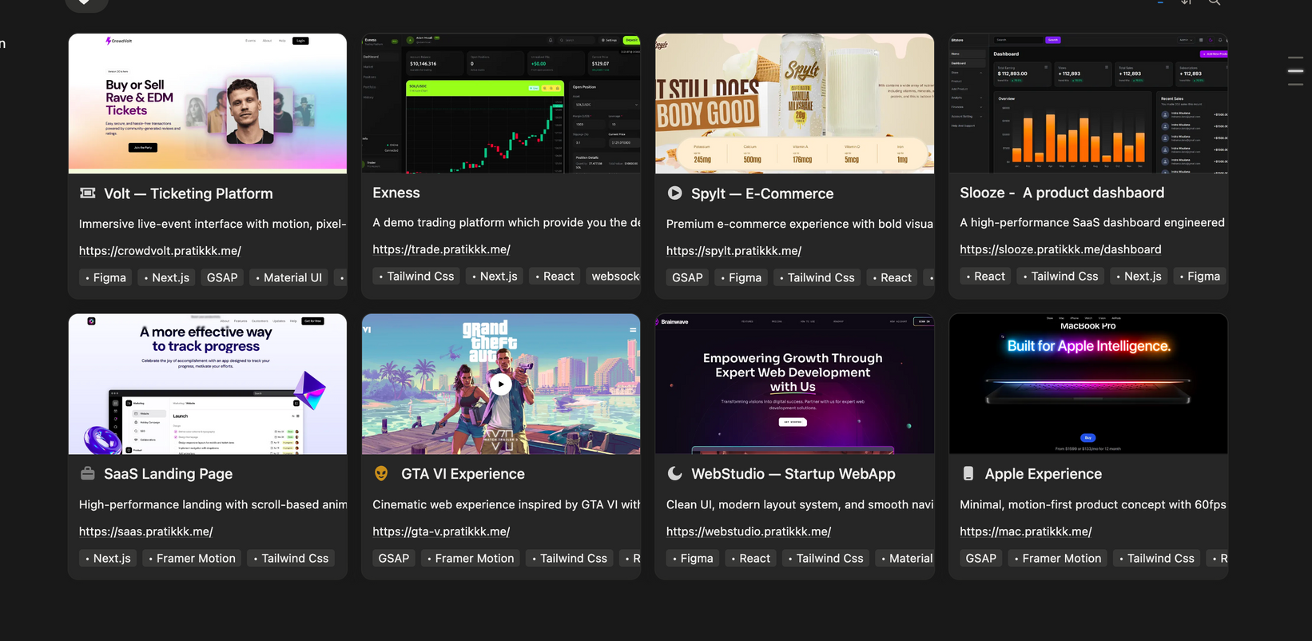
ELEGANT PROJECTS (FRONTEND)
https://pratikkk.notion.site/Design-Code-2a5bee2aac9181189110dfc92d37506c

Slide 15
ELEGANT PROJECTS (FRONTEND)
https://pratikkk.notion.site/Design-Code-2a5bee2aac9181189110dfc92d37506c

Slide 16
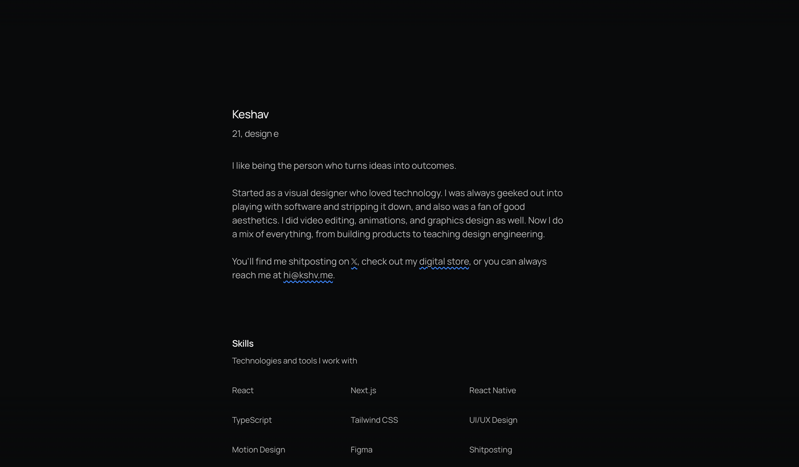
ELEGANT PROJECTS (FRONTEND)
https://www.kshv.me/

Slide 17
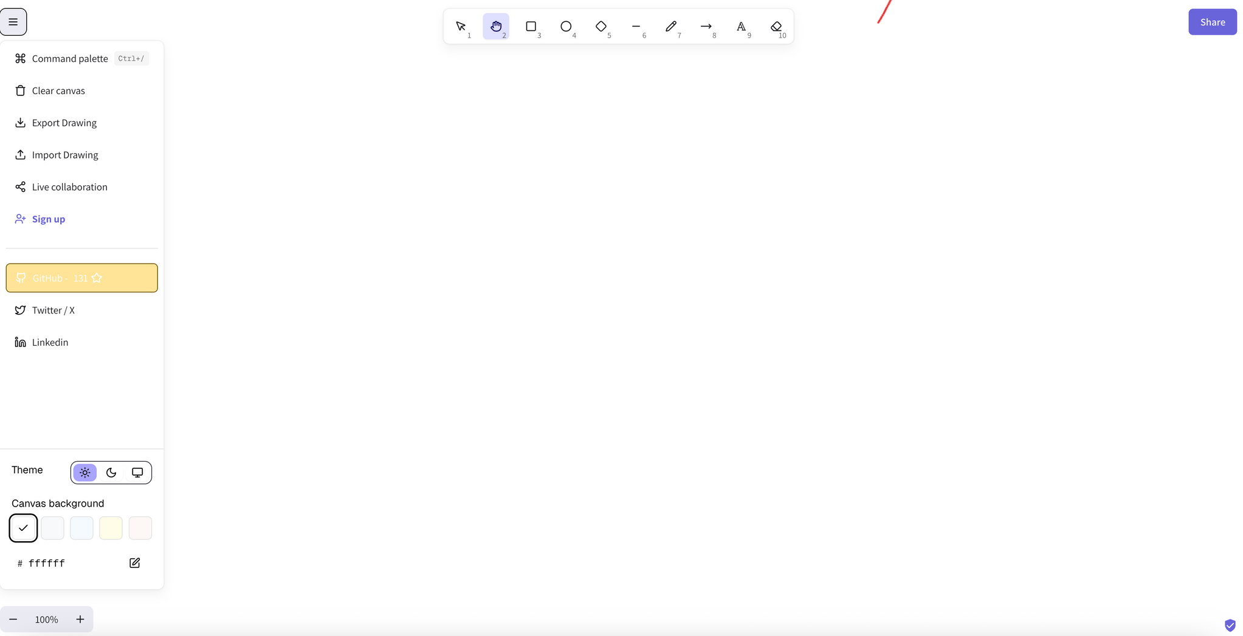
ELEGANT PROJECTS (FULL STACK)
HTTPS://COLLABYDRAW.XYZ/

Slide 18
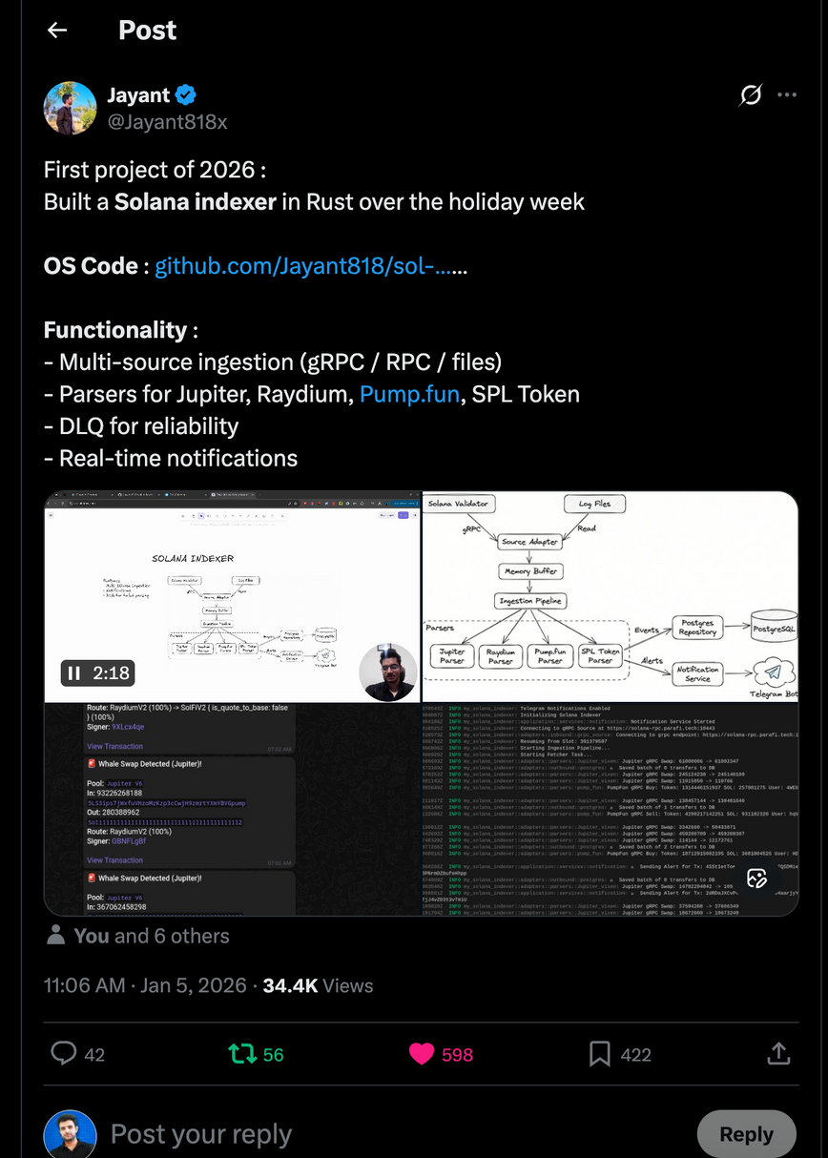
ELEGANT PROJECTS (SOLANA)
https://x.com/Jayant818x/status/2008049944046006282?t=KbcjyAhpTPZdKvN7PRzNng&s=19

Slide 19
ELEGANT PROJECTS (SOLANA)
https://x.com/Jayant818x/status/2008049944046006282?t=KbcjyAhpTPZdKvN7PRzNng&s=19

Slide 20
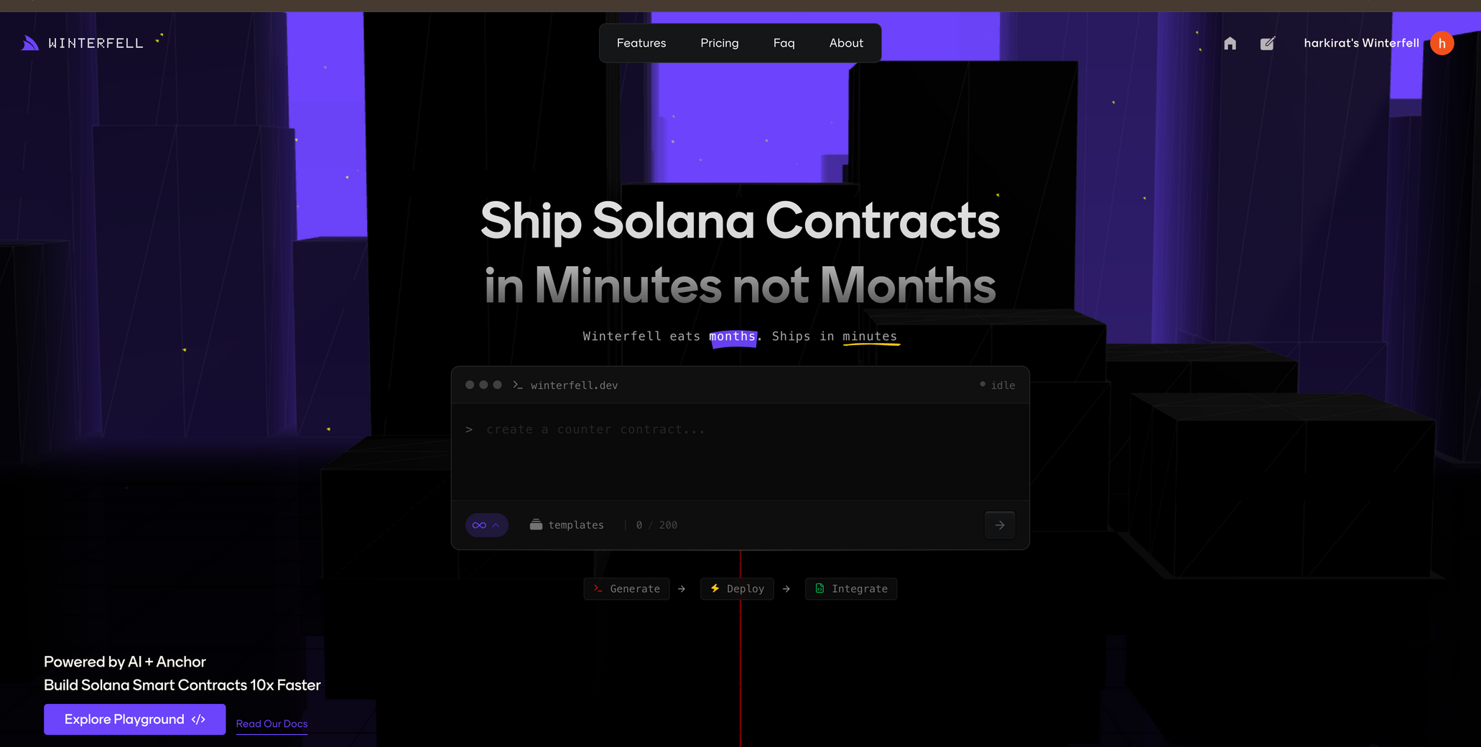
ELEGANT PROJECTS (SOLANA)
https://www.winterfell.dev/

Slide 21
STORY FROM TODAY
(IITR JUNIOUR)

Slide 22
BE INDEPENDENT
BE CONSISTENT
BUILD MUSCLE MEMORY
V EASY TO BE THE TOP 1% OF THIS BATCH

